Slide 1
CARRIER ASSIST (FIND FOR BEST)
WEBSITE

Slide 2
SOCIAL CAUSES:
India's unemployment rate is doubled (1.9 times) in past two years , according to State of India’s Environment (SoE) .
According to the report, the unemployment rate has gone up from four per cent to 7.6 in the last two years (May 2017-April 2019).
So, these causes led us to develop the web platform to increase the employment rate in rural areas.
PERCENTAGE
YEARS
UNEMPLOYMENT RATE IN INDIA

Slide 3
OBJECTIVES:
Carrier Assist (Find for Best) web portal is to increase the employment rate in rural areas.
The unemployed persons can search for a new job and are given potential ideas regarding the startups or business using local resources.
As an additional feature we update information about the upcoming vacancies based on the previous data using Machine Learning algorithm.
The job-providers can post job and recruit candidates based on job seekers resume weightage.
Both the job providers and seekers will have equal priority to give public comments and star rating on each other.

Slide 4













WORK FLOW
IDEAS
UNSELECTED RESUMES
JOB CONFORMATION
ATTENDING INTERVIEW
JOB SEEKERS
JOB PROVIDERS

Slide 5
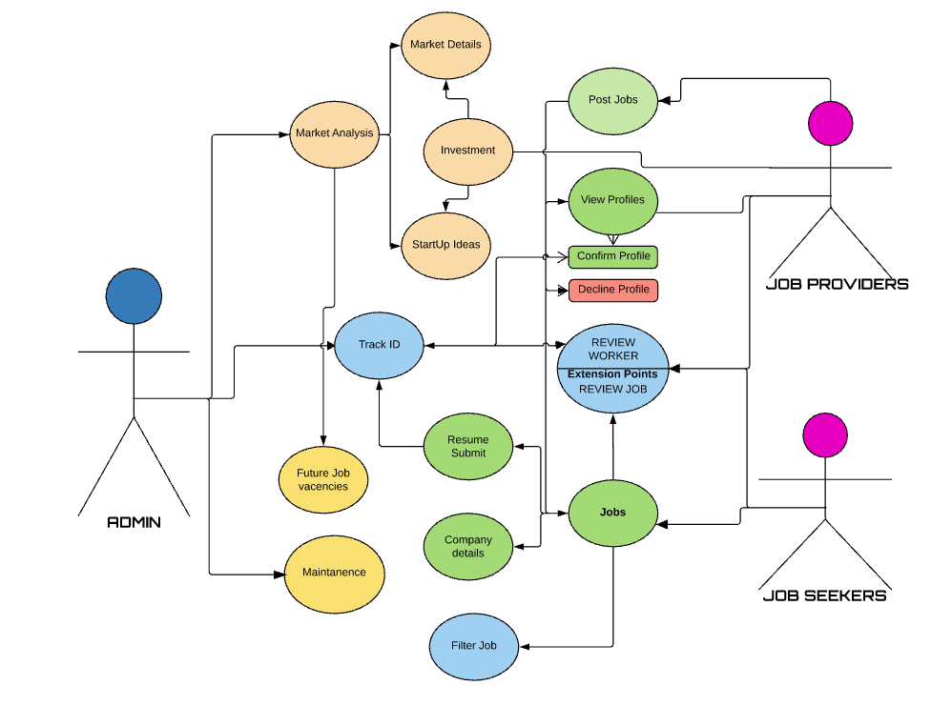
USE CASE

Slide 6



TECHNOLOGY STACK AND FRAMEWORK
Process | Technology
Programing language | CSS,HTML,PHP
Web server | XAMPP SERVER
Data base | SQL database
Machine learning algorithm | Data Analytics
Operating system | Windows
Process | Technology
Selection interview | Track ID
Selecting companies based on ratings | Data analytics
Uploading resume details | SQL data base
Login page | Web server
Process | Technology
Job confirmation letter | Data base
Posting in server | Web server
Vacancies | Data base
Admin server
Job providers
Job seekers

Slide 7
SOFTWARES USED:
S.NO | Software required | Versions | Open source / Licensed software
1) | HTML | 5.1 | Open source
2) | PHP | 7.3.6 | Open source
3) | CSS | 4.0 | Open source
4) | Anaconda(spyder) | Python 3.7.2 | Open source
5) | Jupyter notebook | Python 3.6 | Open source

Slide 8




UNIQUENESS
S.No | Features | Existence | Proposed
1) | Track ID
2) | Star ratings
3) | Suggesting companies
4) | Start up ideas
5) | Upcoming vacancies

Slide 9
DESIGN CONSTRAINT
Online software.
Viewing constraints.
KEY FEATURES
Live updates for upcoming vacancies.
Star rating for both job-seeker and job providers.
Current resources based startups ideas.

Slide 10

SCREEN MOCKUPS - The job-seekers and job-providers
login page

Slide 11
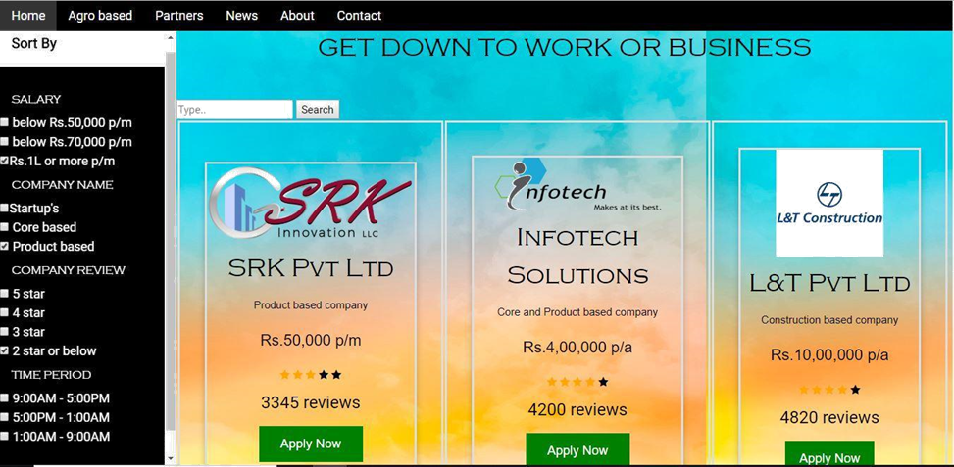
SCREEN MOCKUPS - Job seeker dashboard

Slide 12
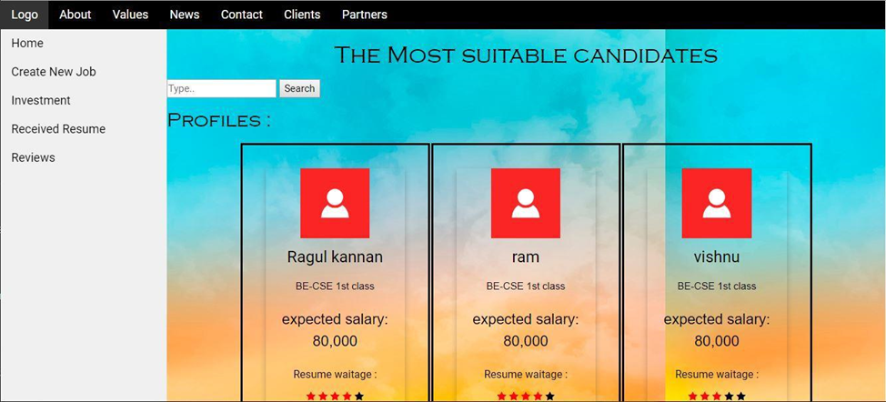
SCREEN MOCKUPS - Job provider dashboard

Slide 13
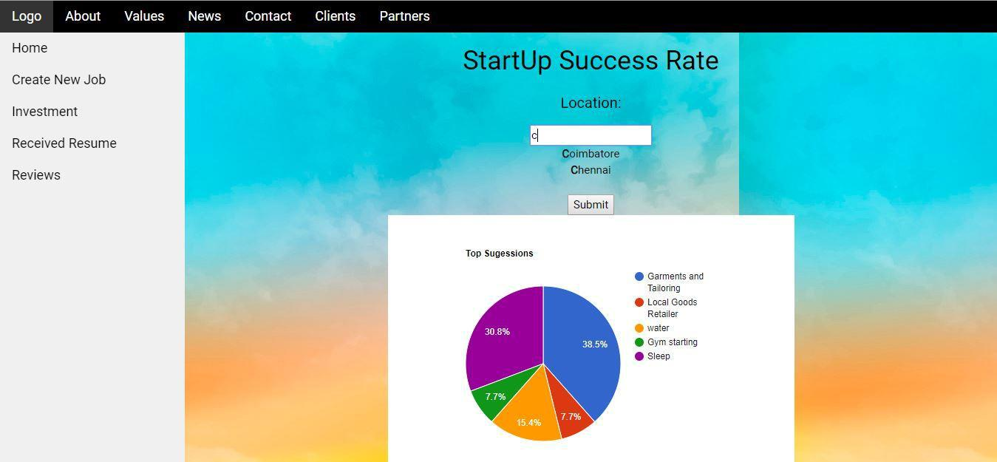
SCREEN MOCKUPS - Start Up/Business ideas

Slide 14

SCREEN MOCKUPS - Upcoming vacancies for job seekers

Slide 15

SCREEN MOCKUPS – Star ratings
Star ratings

